Slide 1
MODULE 3
ARRAY PROCESSORS

Slide 2
SIMD Array Processor
→Synchronous array of parallel processing elements
→A single control unit (CU) broadcasts instructions which are carried out in lockstep by all the processors.
→Multiple processing elements

Slide 3
Contd…
SIMD→ An array processor which can handle single instruction on multiple data streams.
2 Basic architectural organization
Array Processors using random access memory
Associative processors using content address memory.

Slide 4
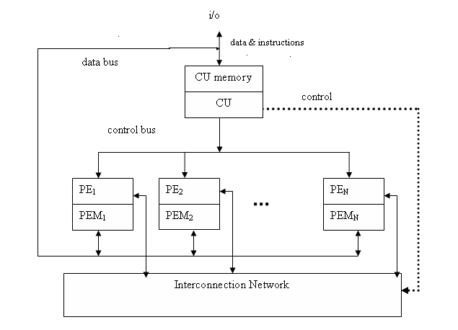
SIMD computer organization Configuration 1(Illiac-IV)

Slide 5
Configuration1 is structured with N synchronized PEs, under the control of one CU.
PEi is an ALU with attached working registers and local memory PEMi, for storage of distributed data.
CU has its main memory for the storage of programs. The system/user programs are executed under the control of CU.
User programs are loaded into the CU memory from an external source.
Function of CU is to decode instructions and determine where the decoded instructions should be executed.

Slide 6
Scalar/control type instructions are executed inside the CU.
Vector operands are distributed to the PEMs before the parallel execution in the array of PEs.
Distributed data can be loaded into the PEMs from an external source via the system data bus/ via CU in a broadcast mode using the control bus.
PEs may be either active or disabled during an instruction cycle.
Masking vector is used to control the status of PEs during the execution of a vector instruction. Only enabled PEs participate in the execution of a vector instruction.
Data exchanges among PEs are done via an inter PE communication

Slide 7
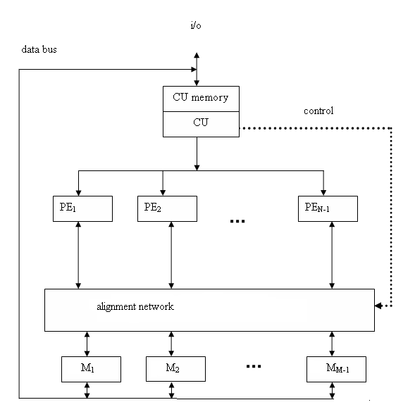
Configuration –II (BSP)

Slide 8
Difference between the configurations --in two aspects
I - local memories attached to the PEs are replaced by parallel memory modules shared by all PEs through an alignment network.
II - inter PE permutation network is replaced by the inter PE memory alignment network which is again controlled by CU.
The alignment network is path-switching network between PEs and parallel memories.

Slide 9
Formally a SIMD computer is characterized by following set of parameters.
C = <N, F, I, M>
N: no. of PEs. For eg for Illiac-IV has 64, BSP 16.
F: set of data routing functions
I: set of m/c instructions for scalar-vector, data-routing and the network-manipulation operations.
M: the set of masking schemes, where each mask partitions the set of PEs into the 2 disjoint subsets (enabled PEs and disabled PEs).

Slide 10
Masking and data routing mechanisms
Masking schemes are used to control the status of each PE.
Each processor with its own memory, includes a set of working registries, flags, Ai, Bi, Ci and Si, logical index register Ii, address register Di, data routing register Ri.

Slide 11
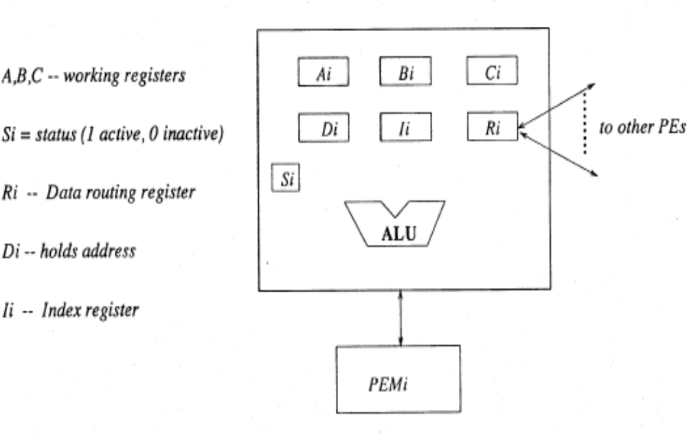
Components in a PE

Slide 12
Inter PE communications
1) Operation Mode:
→The types of communication can be identified :Synchronous and asynchronous.
2) Control strategy:
→The control setting functions can be managed by a centralized controller or by individual switching element. The later strategy is called distributed control and the first strategy corresponds to centralized control.
3) Switching Methodology:
→The two major switching methodologies are circuit switching and packet switching.
4) Network topology
→The topologies can be grouped into two categories :static and dynamic.

Slide 13
SIMD Interconnection Networks
The classification includes 5 types
Static versus dynamic network
2. Mesh-connected Illiac network,
3. Cube interconnection networks,
4. Barrel shifter and data manipulator,
5. Shuffle exchange and omega networks

Slide 14
I) Static versus dynamic network
The topological structure of an array processor is mainly characterized by the data routing network used in interconnecting the processing
→Static networks
Topologies in static network can be classified according to the dimensions required for layout. Examples for one dimensional topologies include linear array.
Two dimensional topology include ring, star, tree, mesh, and systolic array.
Three dimensional topologies include completely connected chordal ring, 3 cube, and 3 cube connected cycle networks.
→Dynamic networks
Two classes of dynamic networks are there. Single stage versus multistage.

Slide 15
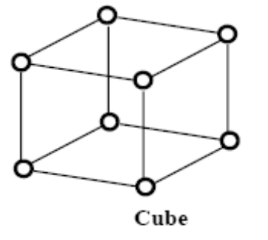
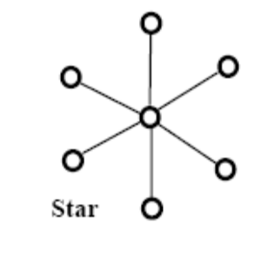


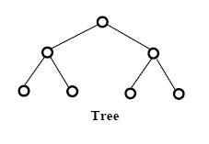
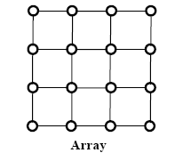
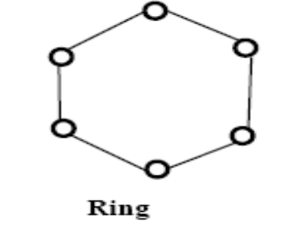
Static Interconnection network topologies

Slide 16
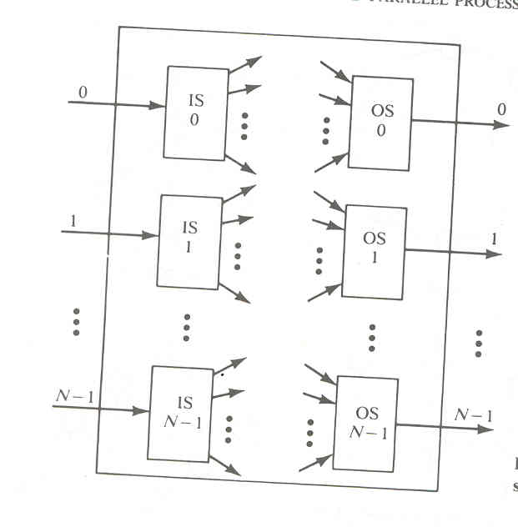
Dynamic Networks
Single stage

Slide 17
Multi stage network
Switch Box
Network topology
Control structure
→One sided
→Two sided
Blocking
Rearrange able
Non blocking network

Slide 18
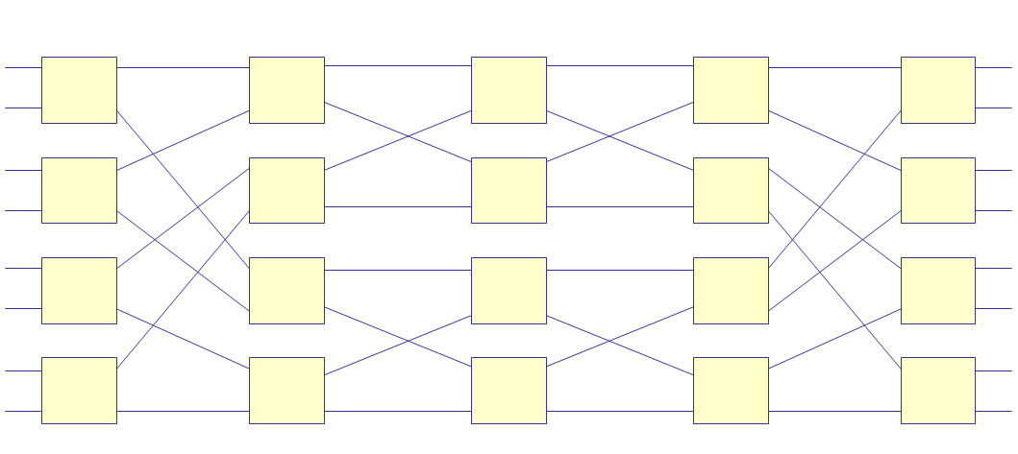
Multistage network::8*8 Benes network

Slide 19
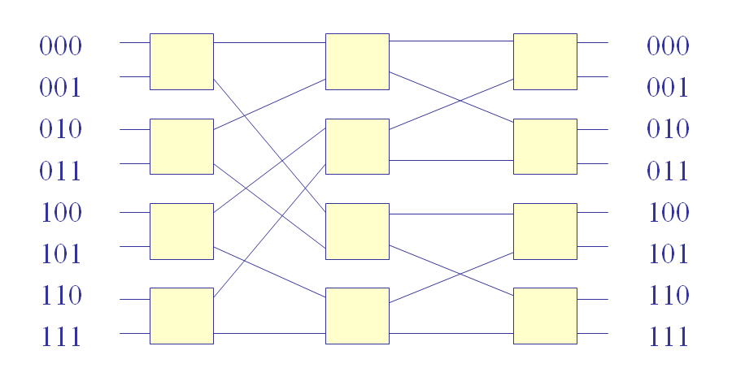
Multistage network::Baseline network

Slide 20
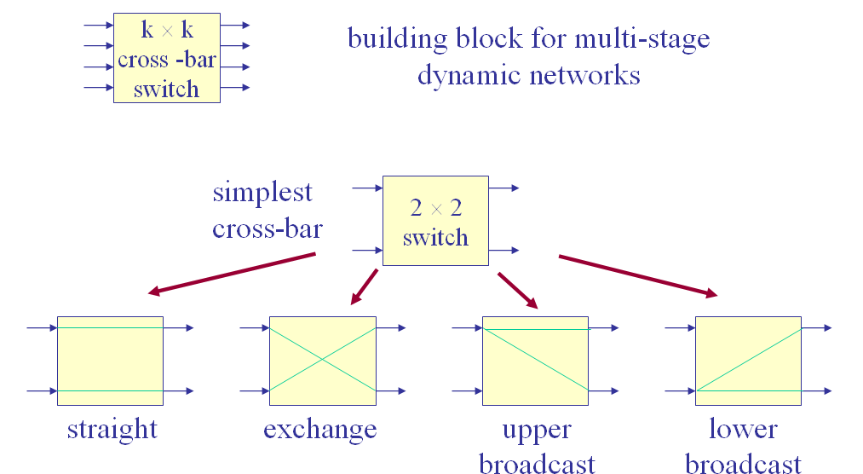
Different interconnection states

Slide 21
2) Mesh-Connected Illiac Network
Communication is possible only between the neighboring nodes.
The output of IS is connected to the inputs of OS.
Each PE_{i} is allowed to send data to PE _{I+1},PE _{i-1},PE,_{i+r} PE_{i-r} where r=√N.
N, is the number of processing elements PE

Slide 22
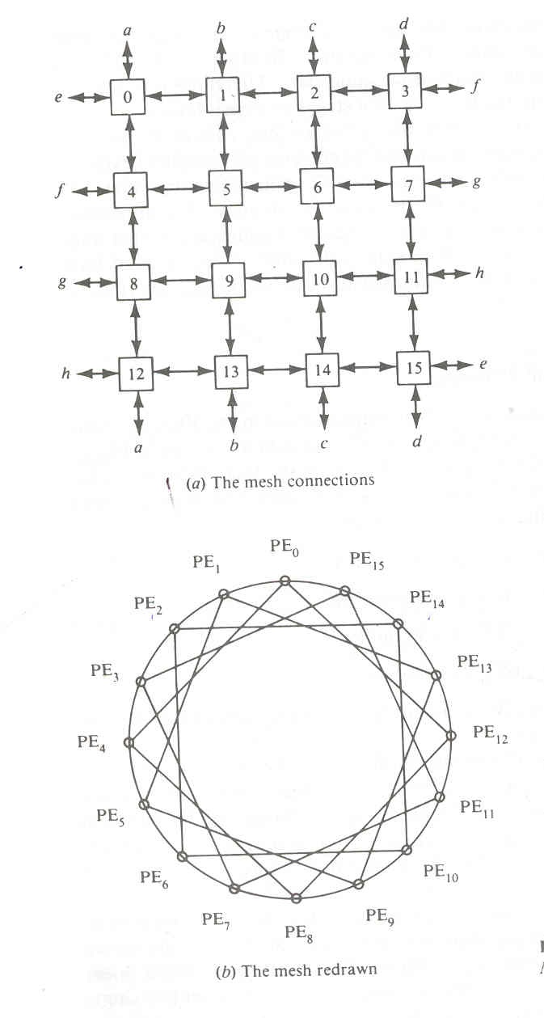

Slide 23
Routing functions..
Formally Illiac network is characterized by following four routing functions.
→R₊₁(i)=(i+1)mod N
→R₋₁(i)=(i-1)mod N
→R_{+r}(i)=(i+r)mod N
→ R_{-r}(i)=(i-r)mod N

Slide 24
Permutations for N=16, r=4
R₊₁=(0 1 2 ……N-1)
R₋₁=(N-1………2 1 0)
R₊₄=(0 4 8 12)(1 5 9 13)(2 6 10 14 )(3 7 11 15)
R₋₄=(12 8 4 0)(13 9 5 1)(14 10 6 2 )(15 11 7 3)

Slide 25
Cube Interconnection Networks
→Recirculating network or multistage network
→Vertical lines connect the vertices PE, whose address differ in MSB.
→Horizontal lines differ in the LSB
→In the ‘n’ cube, each PE located at a corner is directly connected to n neighbors.

Slide 26
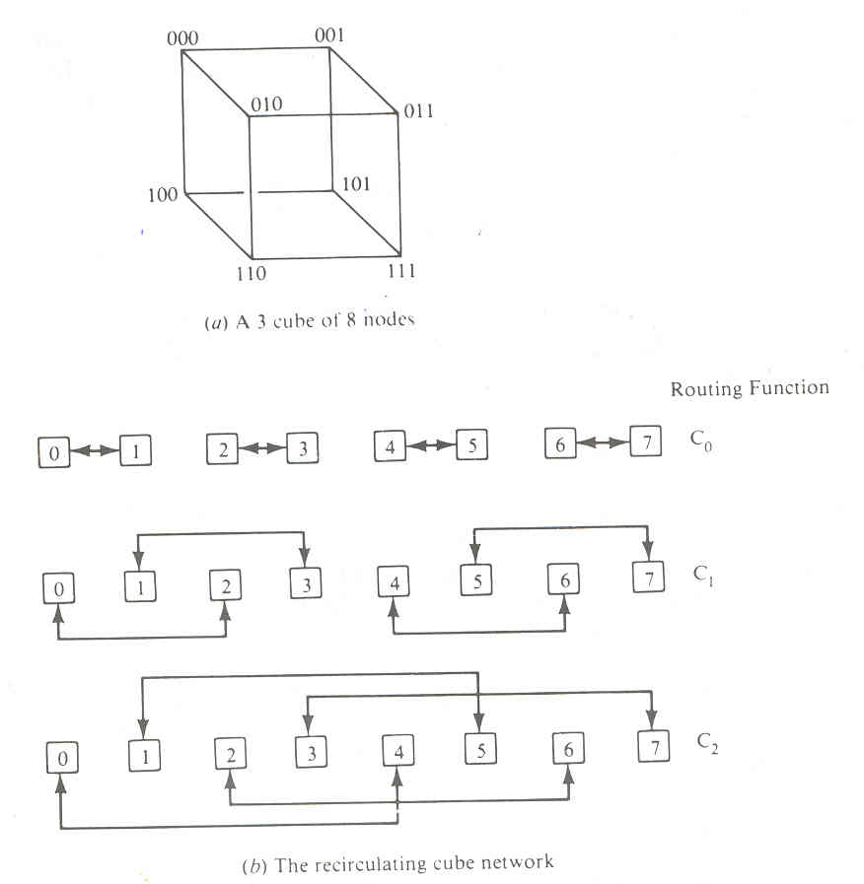
Cube Interconnection Networks

Slide 27
Barrel shifter and Data manipulation
Barrel Shifters are also known as PM2I network
Barrel shifting allows either forward or backward shifting.
Barrel shifter is implemented with multiple stages as a data manipulator.
Data manipulating functions are replicating, permuting, complementing.

Slide 28
Shuffle exchange
Two routing functions: shuffle “S” and Exchange “E”.
→Perfect shuffle: Cuts the decks into two halves from the center and intermixes them evenly
→Inverse perfect shuffle:

Slide 29
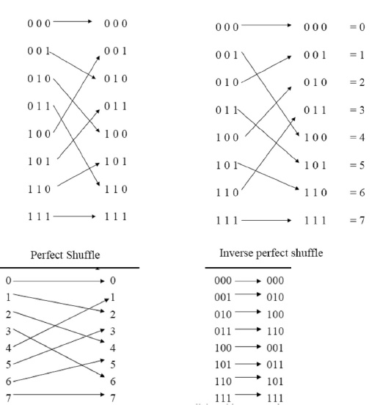

Slide 30
PARALLEL ALGORITHMS FOR ARRAY PROCESSORS
Parallel processing algorithms have been developed by many computer scientists for SIMD computers.
Important SIMD algorithms can be used to perform matrix multiplication, fast Fourier transform (FFT), matrix transposition, summation of vector elements, matrix inversion,
parallel sorting, linear recurrence, boolean matrix operations, and to solve partial differential equations.

Slide 31
SIMD Matrix Multiplication
The differences between SISD and SIMD matrix algorithms are pointed out in their program structures and speed performances.
In general, the inner loop of a multilevel SISD program can be replaced by one or more SIMD vector instructions.
Let A = [a_{ik}] and B = [b_{kJ} ]be n x n matrices. The multiplication of A and B generates a product matrix C = A x B = [C_{ij}] of dimension n x n.
The elements of the product matrix C is related to the elements of A and B by: Cij₌∑a_{ik} x b_{kj}

Slide 32
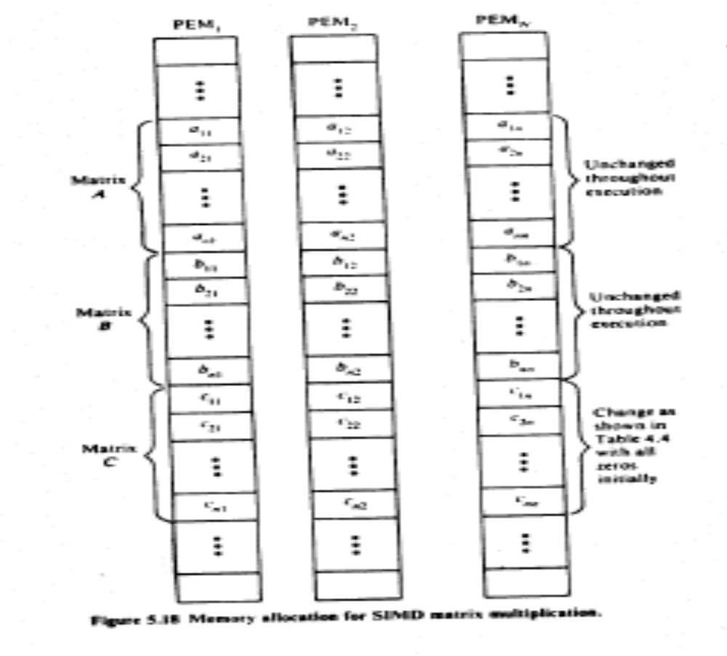

Slide 33
An O(n³) algorithm for SISD matrix multiplication
For i = I to n Do
For j = I to n Do
Cij = 0 (initialization)
For k = I to n Do
C_{ij}=C_{ij}+a_{ik b}ij (scalar additive multiply)
End of k loop
End of j loop
End of i loop

Slide 34
An O(n²) algorithm for SIMD matrix multiplication
For i = I to n Do
Par for k = I to n Do
C_{ik} = 0 (vector load)
For j = I to n Do
Par for k = 1 to n Do
C_{ik} = C_{ik} + a_{ij} . b_{jk} (vector multiply)
End of j loop
End of i loop

Slide 35
Parallel Sorting on Array Processors
An SIMD algorithm is to be presented for sorting n² elements on a mesh-connected (llIiac-lV-Iike) processor array in O(n) routing and comparison steps.
This shows a speedup of O(log2 n) over the best sorting algorithm, which takes O(n log2 n) steps on a uniprocessor system.

Slide 36
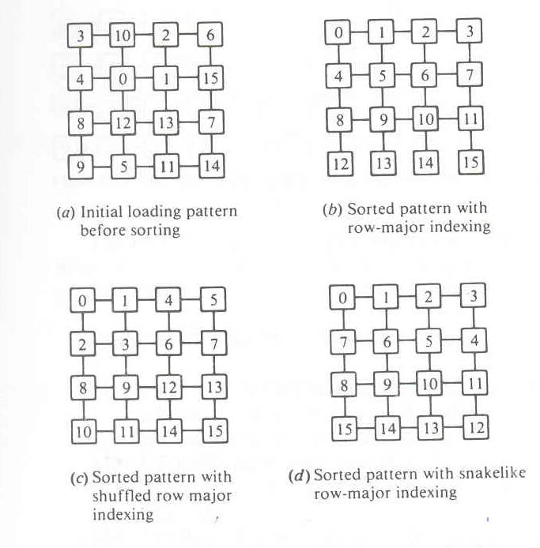

Slide 37
Given two sorted columns of length j > 2, the M(j, 2) algorithm consists of the following steps:
Example 5.6: The M(j, 2) sorting algorithm
J 1: .Move all odds to the left column and all evens to the right in 2tk time.
J2: Use the odd-even transposition sort to sort each column in 2jtk + jtc time.
J3: Interchange on even row in 2tk time.
J4: Perform one comparison-interchange in 2tk + tc time

Slide 38
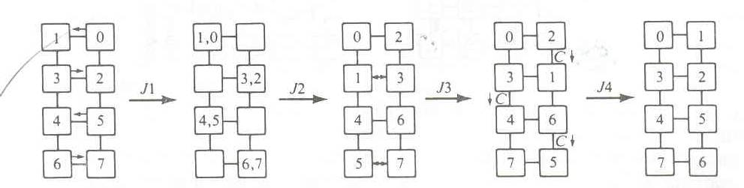

Slide 39
The M(j,k) algorithm
.Perform single interchange step on even rows
.Unshuffle each row.
.Merge by calling algorithm m(j,k/2)
.Shuffle each row
.Interchange on even row
Comparison interchange

Slide 40
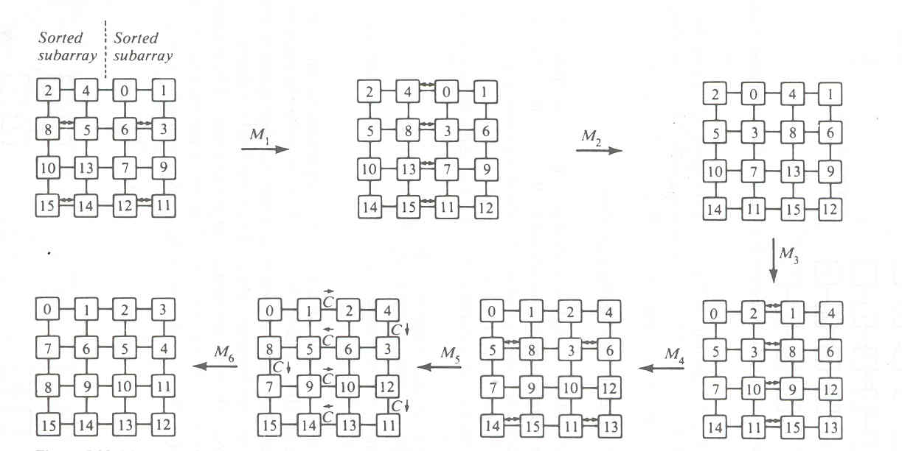

Slide 41
Associative array processing.
Associative Memory Organizations
Data stored in an associative memory are addressed by their contents. In this sense, associative memories have been known as content.-addressable memory.

Slide 42
Parallel search memory and multiaccess memory . The major advantage of assosiative memory over RAM is its capability of performing parallel search and parallel search and parallel comparuison operations.

Slide 43
The associatuive memory array consists of n words with mbits per word.
Each cell in the array consists of a flip flop associated with some comparison logic gates for pattern match and read write control.
A bit slice is a vertical column of bit cells of all the words at the same position.

Slide 44
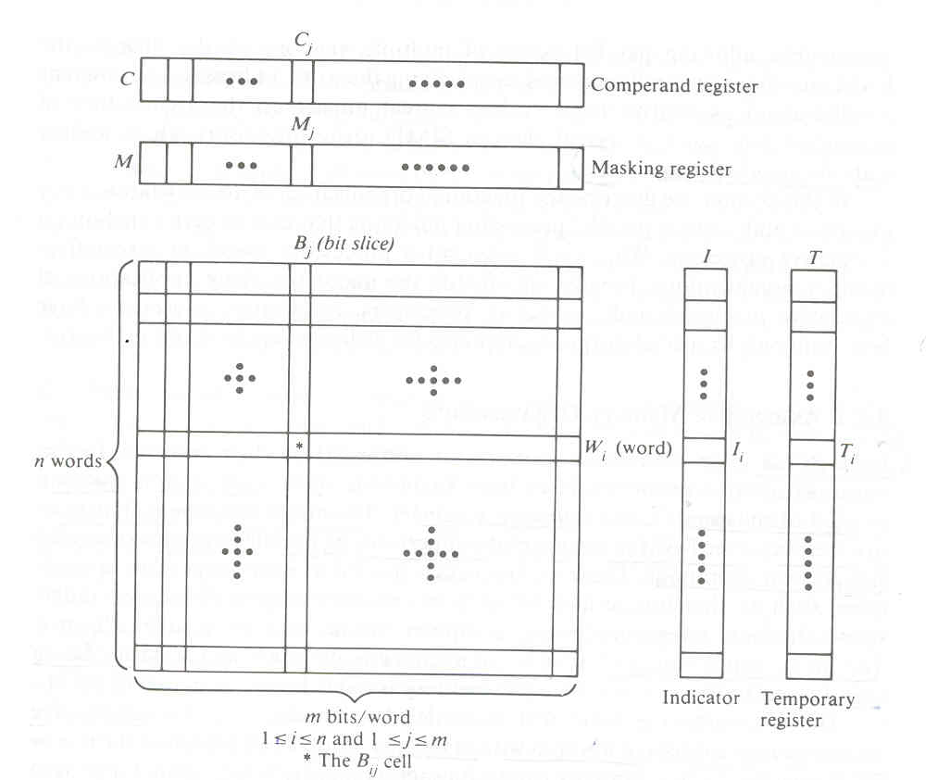
Associative memory array and working registers

Slide 45
, we consider below two different associative memory organizations:
The bit parallel organization In a bit parallel organization, the comparison process is performed in a parallel-by-word and parallel-by-bit fashion.
Bit serial organization The memory organization in Figure 5.34b operates with one bit slice at a time across all the words. The particular bit slice is selected by an extra logic and control unit.

Slide 46
The associative memories are used mainly for search and retrieval of non- numeric information. The bit serial organization requires less hardware but is slower in speed. The bit parallel organization requires additional word-match detection logic but is faster in'speed.

